Slide 1
SOFTWARE TESTING
BUSINESS REQUIREMENTS ANALYSIS
INSTRUCTOR GUIDES: PH.D. ĐỖ NHƯ TÀI
STUDENTS PERFORM:
TRANG GIA HUY
NGUYỄN LÊ QUỲNH HƯƠNG

Slide 2
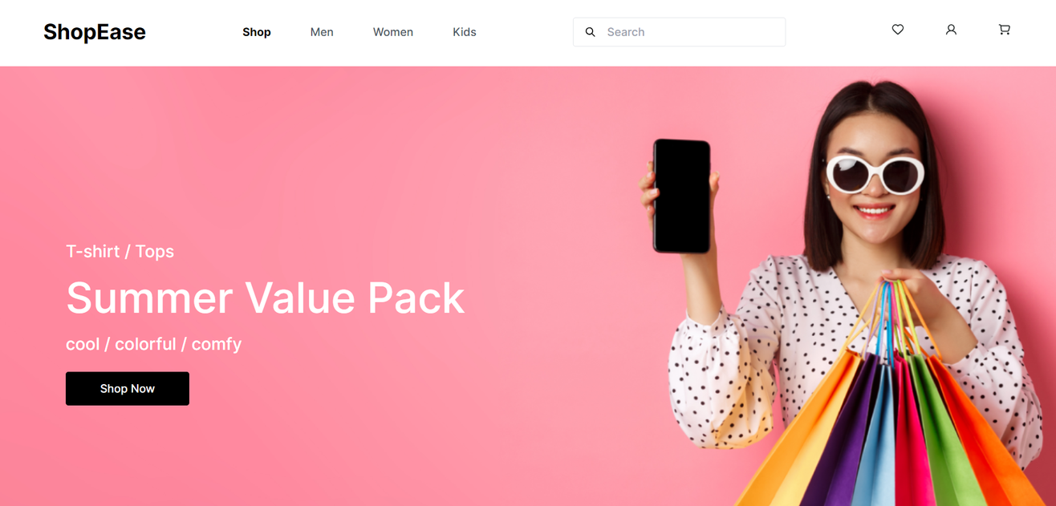
INTRODUCE
Shopease – Full-Stack E-Commerce App
  Backend: Spring Boot (modular service-controller-repository)
  Front end: React (component-based UI)
  Key features: Product browsing, category management, user authetication, shopping cart, order placement, address handling.
  Tech stack: Spring security (JWT), JPA/Hibernate for persistence

Slide 3
BUSINESS CONTEXT
01
02
03
04
AUTHENTICATION & ACCESS CONTROL
PRODUCT CATALOG
SHOPPING CART
ORDERING & PAYMENT
Buyer browses & filters products; SysAdmin adds, edits, deletes, organizes products.
Buyer adds/removes items, views summary, checks out; SysAdmin monitors carts.
Buyer places orders & tracks status; SysAdmin oversees all orders
Buyer registers/logs in; SysAdmin manages products, categories, orders.
05
06
07
FILE UPLOAD
ADDRESS MANAGEMENT
INITIAL SETUP
SysAdmin uploads product images/resources.
Buyer manages delivery addresses for checkout.
Create admin, buyers, and sample data for testing/demo.

Slide 4
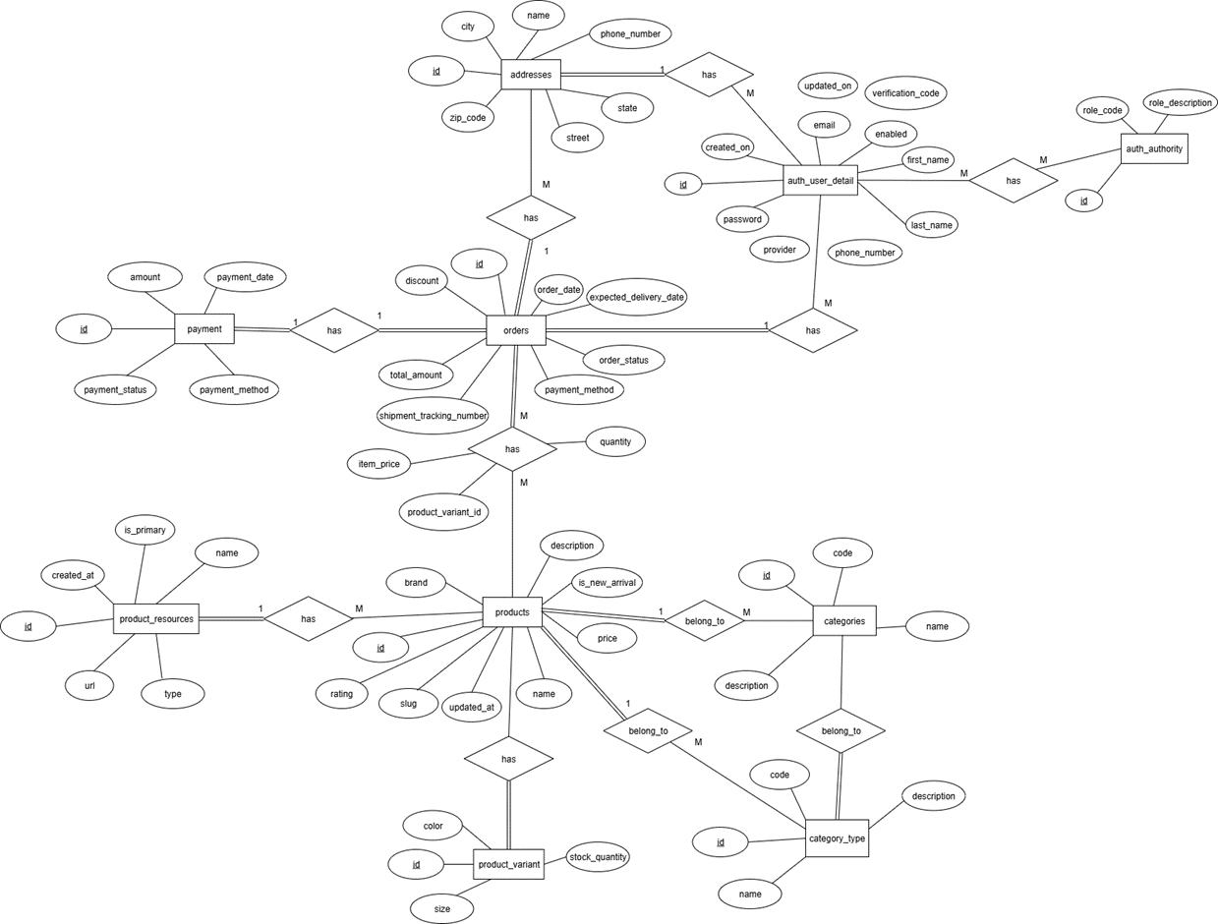
CONCEPTUAL MODEL

Slide 5
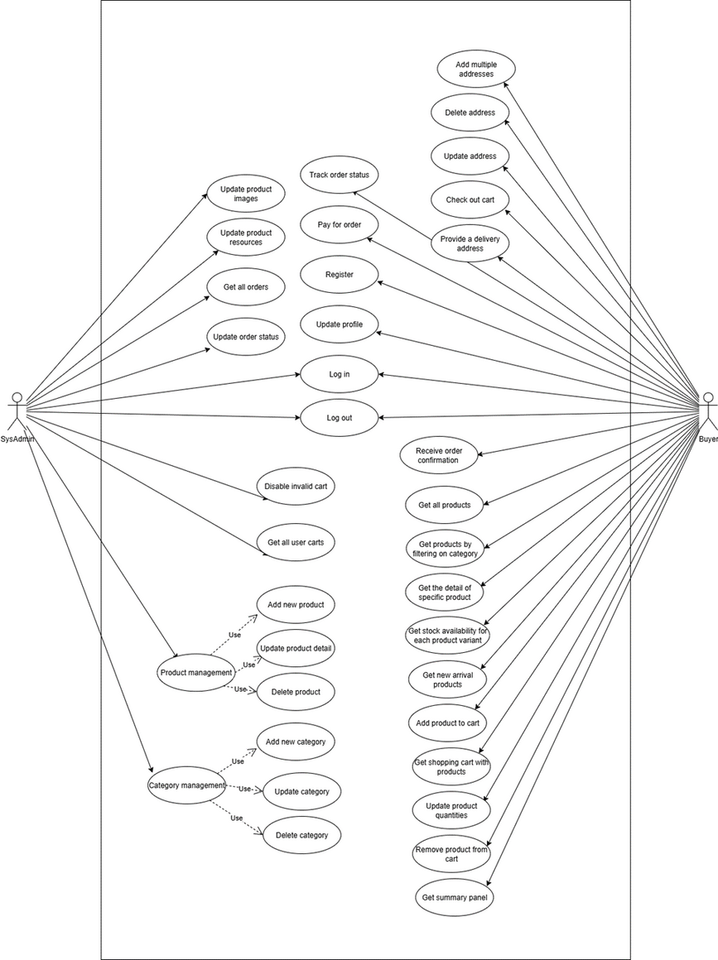
USER STORY AND USE CASE
AUTHENTICATION & ACCESS CONTROL
ORDERING & PAYMENT
01
04
01
02
PRODUCT CATALOG
05
ADDRESS MANAGEMENT
01
SHOPPING CART
FILE & RESOURCE MANAGEMENT
03
06
01
04

Slide 6
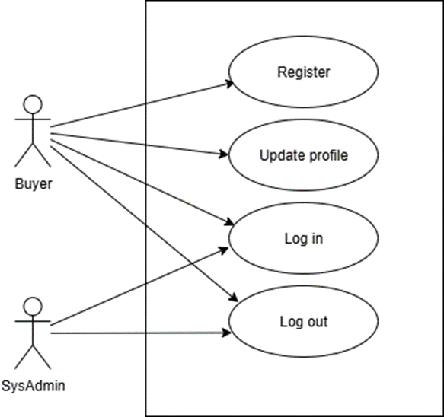
AUTHENTICATION & ACCESS CONTROL
UC1
As a Buyer, I want to register an account so that I can shop online.
As a Buyer, I want to login with my credentials so that I can access my personal shopping account.
As a Buyer, I want to update my profile information so that my personal details are accurate.
As a Buyer, I want to logout so that I can secure my account after shopping.
As a SysAdmin, I want to login with admin credentials so that I can manage the system.
As a SysAdmin, I want to logout so that I can secure my account.
02
03

Slide 7
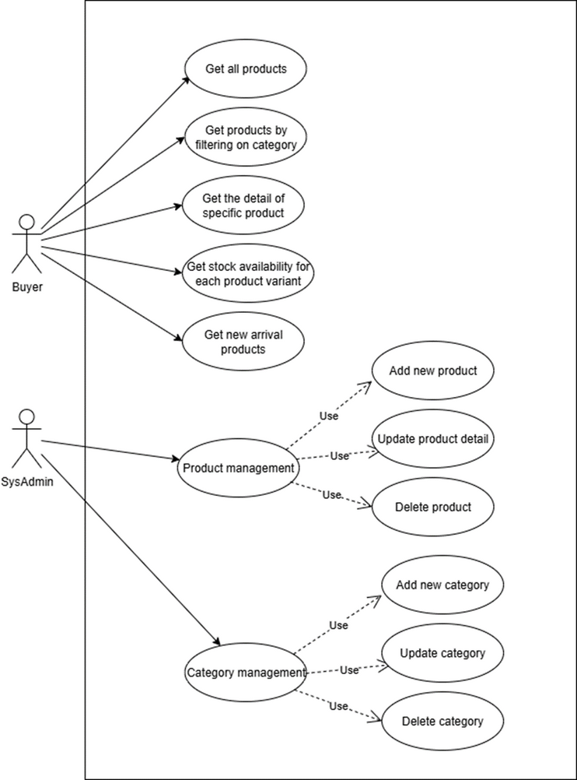
PRODUCT CATALOG
UC2
As a Buyer, I want to browse all products so that I can see the available clothing items.
As a Buyer, I want to filter products by category so that I can quickly find what I need.
As a Buyer, I want to view product details (name, description, price, brand, rating, images, variants) so that I can decide whether to purchase.
As a Buyer, I want to see stock availability for each product variant so that I know if my size/color is available.
As a Buyer, I want to see new arrival products so that I don’t miss the latest items.
As a SysAdmin, I want to add new products so that I can expand the catalog.
As a SysAdmin, I want to update product details so that information is always correct.
As a SysAdmin, I want to delete products so that outdated or unavailable items are removed.
As a SysAdmin, I want to manage categories and category types so that products are organized logically.
02
03

Slide 8
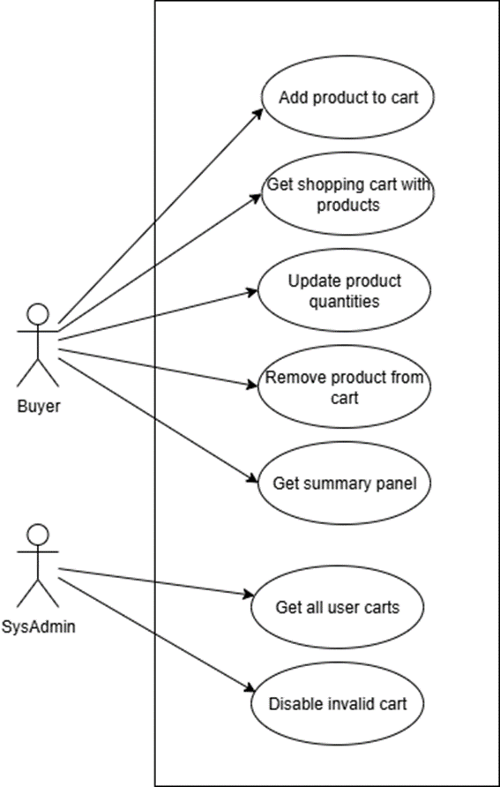
SHOPPING CART
UC3
As a Buyer, I want to add products to the cart from the product list or detail page so that I can prepare for checkout.
As a Buyer, I want to view my shopping cart so that I can review selected items.
As a Buyer, I want to update product quantities in the cart so that I buy the correct amount.
As a Buyer, I want to remove products from the cart so that I can adjust my purchase.
As a Buyer, I want to see a summary panel (subtotal, shipping cost, total) so that I know the final amount.
As a SysAdmin, I want to view all user carts so that I can detect invalid carts.
As a SysAdmin, I want to disable invalid carts so that the system remains consistent.
03

Slide 9
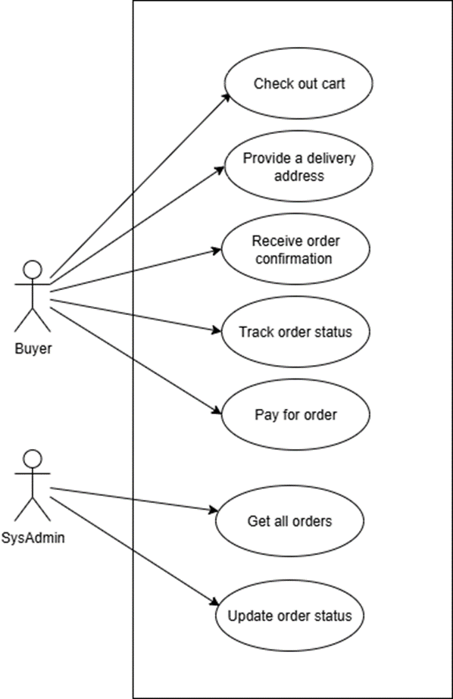
ORDERING & PAYMENT
UC4
As a Buyer, I want to checkout my cart so that I can place an order.
As a Buyer, I want to provide a delivery address at checkout so that my order is shipped correctly.
As a Buyer, I want to receive order confirmation so that I know my purchase is successful.
As a Buyer, I want to track my order status (pending, confirmed, shipped, delivered) so that I know where my order is.
As a Buyer, I want to pay for my order securely so that I complete the purchase.
As a SysAdmin, I want to view all orders so that I can monitor system activity.
As a SysAdmin, I want to update order status so that delivery progress is reflected accurately.
02

Slide 10
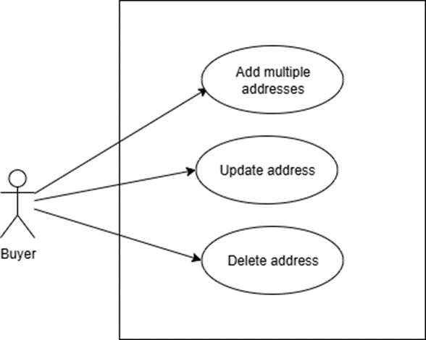
ADDRESS MANAGEMENT
UC5
As a Buyer, I want to add multiple addresses so that I can choose different delivery locations.
As a Buyer, I want to update or delete my addresses so that my information stays up-to-date.
02
03

Slide 11
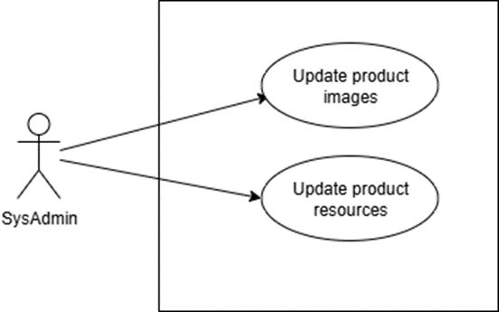
FILE & RESOURCE MANAGEMENT
UC6
As a SysAdmin, I want to upload product images so that products have visuals in the catalog.
As a SysAdmin, I want to update product resources (primary and secondary images) so that Buyers see correct visuals.
02
03

Slide 12
INITIALIZATION & SAMPLE DATA
As a SysAdmin, I want to have an initial admin account so that I can start managing the system.
As a SysAdmin, I want to have sample Buyer accounts and product data so that the system can be tested and demonstrated.
UC6
02
03

Slide 13

SOFTWARE TESTING
THANK YOU FOR YOUR ATTENTION
PHONE
0338985475

